Slide 1
Real-time Analytics with Storm over Streaming Data from meetup.com
Scalable Systems for Data Science
Shilpa Chaturvedi (12899)
Md. Imbesat Hassan Rizvi (12214)
Notes:
We designed this template so that each member of the project team has a set of slides with its own theme where he/she can present their research. Members, here’s how you add a new slide to just your set:
Mark where you want to add the slide: Select an existing one in the Thumbnails pane, click the New Slide button, then choose a layout.
The new slide gets the same theme as the previous one you selected.
Careful! Don’t annoy your fellow presenters by accidentally changing their themes. That can happen if you choose a theme Variant from the Design tab, which changes all of the slides in your presentation to that look.

Slide 2
Introduction
Stream Processing, Apache Storm, Meetup

Slide 3
Stream Processing & it's challenges
Continuous flow of data as streams.
Real-time decisions and analytics to be performed quickly.
Streams often delivered rapidly, Velocity aspect of Big Data
Processing all streams together can consume entire available main memory
Data rates may vary considerably.
Streams are unbounded, continuous analytics.
Often approximate answers are reasonably accurate and more efficient.

Slide 4

Apache Storm
Open source, distributed real-time computation system.
Fault tolerant, easy to setup & operate and scalable.
Also called Hadoop for Real-time.
Storm topology consumes streams of data and processes those streams in arbitrarily complex ways.

Slide 5
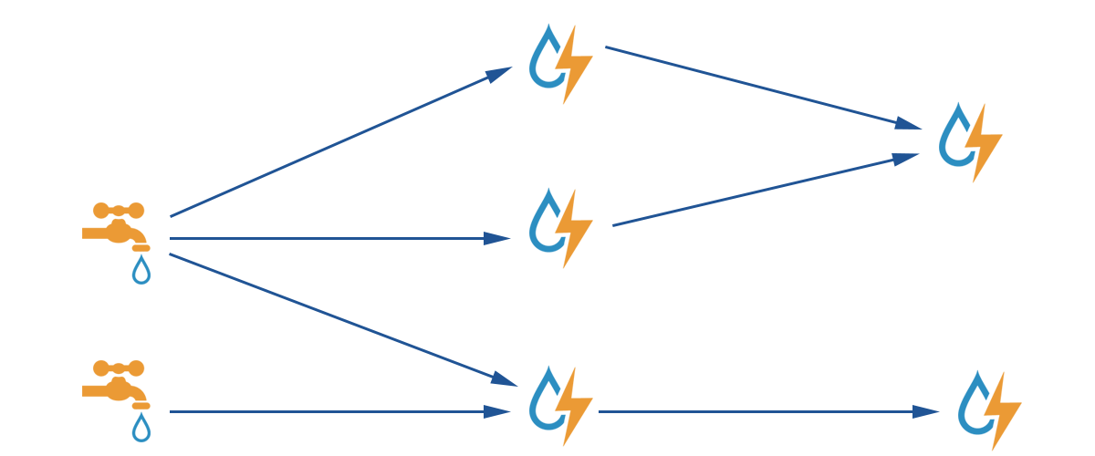
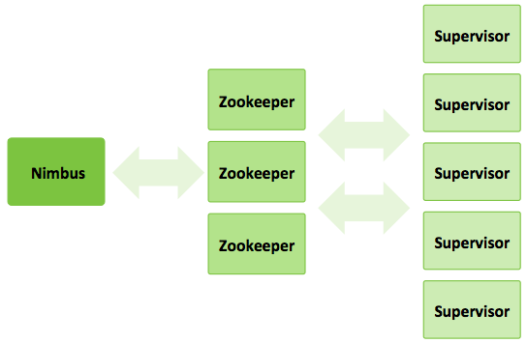
Apache Storm – contd...
Storm Architecture
Storm Data Flow

Slide 6
Meetup Platform
An online social networking platform to facilitates offline group meetings at various venues and on various categories.
Members can organize public or private events within their Meetup groups.
Anyone can browse, search for, and register to events based on their interest and locality.
It allows easy collaborations and event organization for people sharing common interests

Slide 7
Stream API Provided
The meetup platform provides the following streaming API :
1. rsvps
2. open_events
3. photos
4. open_venues
5. event_comments
We are using rsvps and open_events stream in our project.

Slide 8
Open Event Stream
Some Major fields present
1. Event details – id , name, url , duration
2. Venue details – city, country ,
3. Payment required - In form of 0 or 1
4. Event category –For example 'tech', 'career-business', 'fitness' ,'socializing'
5. status of event
6. Group details – name , id , url of the organizing group

Slide 9
RSVP Stream
Some Major fields present
1. Event details – event id , name , url , time
2. Response – Yes, No
3. Member details – name , id , photo
4.Venue details – exact location of the event
5. Group details - Organizing group information like group name, id, categories tagged to group.

Slide 10
Distinct Count of stream elements
Estimate unique no. of elements in a data stream

Slide 11
Distinct Count
Distinctly different elements appeared in Stream
Our use case:
Given a location, unique number of attendees.
Attendees in same location may rsvp for different events. Avoid over-estimation.
Exact count – in Memory member id storage for look up
Probabilistic Count – Approximate estimation of unique count so far. No member id storage/lookup.

Slide 12


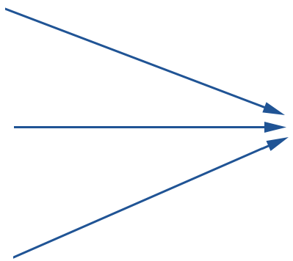
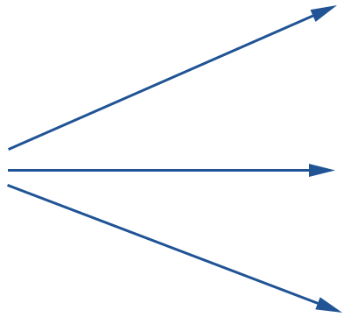
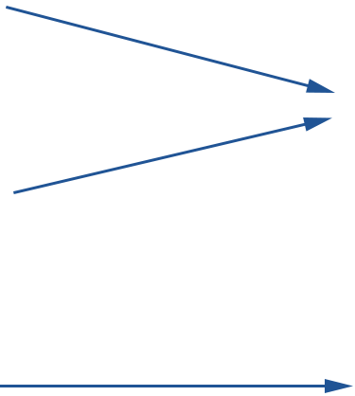

Distinct Count – Topology
Shuffle Grouping – All to one
Shuffle Grouping
Field Grouping
Stream Gen Spout – Reads JSON stream data from HDFS files and emits tuples with fields like country, city, event name, member id etc.
Field Filter Bolts – Check against filtering criteria e.g. location and forwards fulfilling tuples
Field Counter Bolt (HashSet or Durand-Flajolet based) - maintains unique count of fields from incoming tuples and forwards it.
Unique Count Aggregator – Receives individual unique counts from previous level bolts and sums them up

Slide 13
Distinct Count – Exact Count
The topology as described before differs only at the distinct count computation step.
Create HashSet<elements> in each field count bolt.
For every incoming tuple:
If not HashSet.contains(element):
HashSet.add(element)
Emit(BoltIndex, HashSet.size())

Slide 14
Distinct Count – Durand-Flajolet Algorithm
n num of buckets. // 1 << bucketParam
hv HashValue(element)
bucketId hv & (n - 1)
modified_hv hv >> bucketParam
maxZeros[bucketId] max(maxZeros[bucketId], trailZeros(modified_hv))
avgMaxZeros sum(maxZeros) / n
distinctCount ( 2^(avgMaxZeros) ) x n x magicNum // magicNum = 0.79402

Slide 15
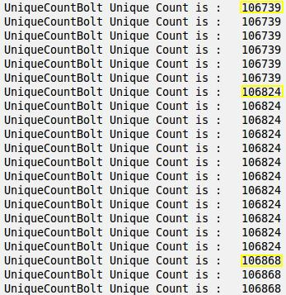
Final Topology Output
This is the final output from the "UniqueCountBolt" aggregator bolt.
For every stream input processed, the aggregator bolt updates the distinct count and displays it (in this case writes to an HDFS file).

Slide 16
Upcoming events
Know upcoming events in a location on a given date

Slide 17
Location specific upcoming event on a given date
Motivation – We are going to visit a foreign country, hence want to know meetups happening there on a specific date or within a range of date.
Will be helpful in aligning, if possible, our schedule with the events of our interests.
The use case is much more general given a location.

Slide 18
Location based upcoming events - Topology
Shuffle Grouping – All to one
Shuffle Grouping
Field Grouping
Field Grouping
Stream Gen Spout – Reads JSON stream data from HDFS files and emits tuples with fields like country, city, event name, event time, status etc.
Field Filter Bolts, Level 1 – Checks whether incoming stream corresponds to status "upcoming" and accordingly forwards it.
Field Filter Bolts, Level 2 – Checks against location and whether the event name has been processed before or not and accordingly forwards it.
Upcoming Event Aggregator – Receives filtered tuples and outputs those events with event time on specified date or within a range of date

Slide 19
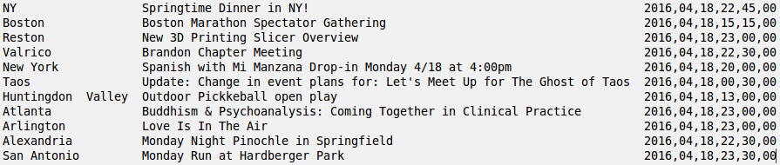
Upcoming Events on a date – Demonstration
Location filter – Country (US)
Looking for events on date – 18.04.2016
Output:
List of city wise events with event time happening in "US" on the specified date.

Slide 20
Stream Sampling
Sampling and Anaytics

Slide 21
About Sampling
Approximate sampling is required for stream processing when the velocity of stream data is high and we cannot process all data as it arrives
Extracting reliable samples from Stream is needed such that it does not affect the overall data distribution
Some of the techniques used are hashing and creating buckets.
Generally sampling is used along with other topologies.

Slide 22
Randomized Sampling
We did not use hash based sampling as our intention is to check sampling accuracy across multiple fields like location, categories and payment requirement
Using hash function based approach might lead to skewed samples
In our sampling approach, every tuple is given a fair chance to be selected in the sample by generating a random number.
To obtain a fraction a/b of original data, we consider the record in sample if the random number generated is less than a.
Of course, sampling in this case will depend upon the uniformity of random number generator.

Slide 23
Analytics using Sampling
We have used sampling to capture the following data points from open_events stream.
Total count of events happening in each city.
Total tech events happening in each city
Total number of paid events happening in each city
For the same data points, we have also calculated the exact counts to compare effectiveness of sampling.

Slide 24
Sampling – Topology
Global Grouping – All to one
Fields Grouping
Open Events Spout
Counting and Sampling Bolts
Sampling Report Bolt

Slide 25
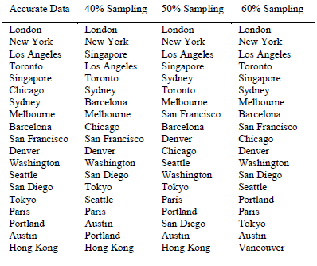
Results - Sampling

Slide 26
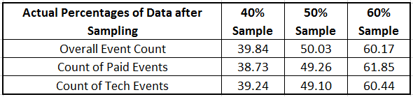
Results – Uniform Sampling on each data field
Sampling Rate | Total Event Count | Total Tech Event count | Total Paid Event Count
Accurate | 55237 | 4004 | 2241
60 percent | 33238 | 2420 | 1386
50 percent | 27633 | 1966 | 1104
40 percent | 22008 | 1571 | 868

Slide 27
Bloom Filters
Probabilistic Filtering of Meetup Members

Slide 28
Bloom Filter - Introduction
A Bloom filter is a probabilistic data structure that can indicate quickly, in a memory-efficient manner, whether an element is present in a given set or not
A Bloom filter can tell us that the element is either "definitely is not in the set" or "may be in the set"
Driven by:
Expected number of elements (n)
False positive probability (fpp)
Size of the bit vector (m)
Number of hash functions needed (k)

Slide 29
Bloom Filter – Use Case
Hypothetical scenario where we classify a set of meetup.com members as "well-behaved members" based on their historical RSVP activities
There are some questionable users and they conduct a burst of activities once in a while, where they send RSVP responses to mislead genuine audience, or conduct a denial of service attack
Solution: Block out members with questionable RSVP behavior
Check the members from the incoming bursts of RSVP stream against a prepared Bloom filter of well-behaved users
Only those identified as being present in the filter can be let in
Might still let through some of the misbehaving members, but it is guaranteed that all the genuine users' responses are honored, and a majority of the bad users are stalled

Slide 30
Bloom Filter – Topologies
One topology to prepare the Bloom filter on the "well-behaved users" data
For supporting accurate count comparison, we populate both a Bloom filter and a HashMap with this data
HashMaps are proven through these experiments to be prohibitive for large data – as big as 125 times the Bloom filter in worst case examples on this data
Second topology checks for Bloom filter and HashMap membership, to bring out the actual false positive percentage (FPP)
For the example run, data considered:
Expected count of members: 125000, 150000, 175000, 200000
Desired FPP: 0.05, 0.1, 0.5

Slide 31
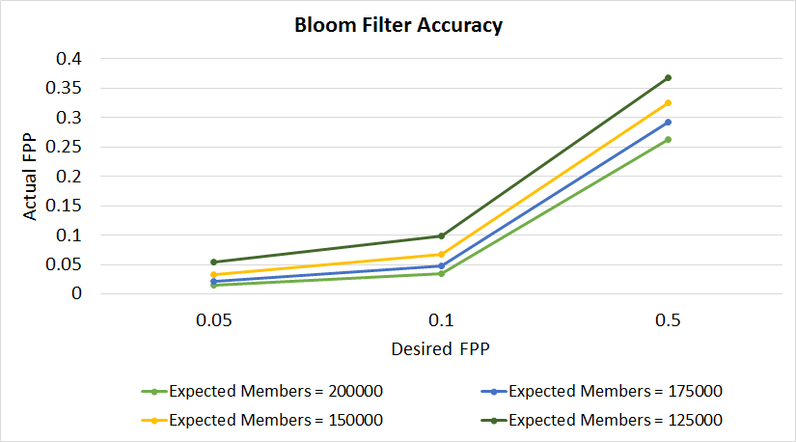
Desired FPP vs Actual FPP
While the Google Guava implementation of the Bloom Filter takes in desired FPP, it tries to achieve an actual FPP that is upper-bounded by the desired FPP. The plots show this, for varying number of expected members and desired FPP data.

Slide 32
Trending Events
Calculating Real Time Trends

Slide 33
Trending Events
Inspiration came form Twitter Trending Tags
Event A to be more popular than Event B (for a given time span) if Event A has received more positive RSVPs than Event B.
The logic for trending is the implementation of a sliding window and ranking the events based on the aggregate count of event windows
The window is periodically advancing to consider more recent data and leave old data behind. While doing so, it is also emitting the trending events.

Slide 34
Sliding Window
A queue is maintained for every event, and data collected at some interval for each event is pushed to the queue.
A window of size say "m" is sliding on top of queue and the interval counts under the window are aggregated and emitted. After emitting, the window advances and removes the least recent data out of window.
We can represent sliding window count for an event at any point of time, say "t", as sum of interval counts from time count at time "t" to count at time "t+m"

Slide 35
Topology
Field Grouping
Global Grouping
Field Grouping
RSVP Stream Spout
Count Bolts
Aggregation bolts with sliding window
Ranking Bolt, emits TopN events
Report Bolts writes to redis/file system

Slide 36
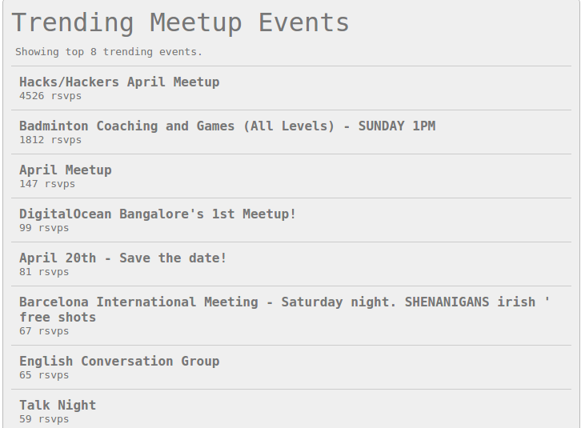
Data Observations
This is how Top N trending items look when used with Redis for storing and continuous updating trending items. The basic interface is done as a web app written in python and JavaScript.

Slide 37
Counting 1s in a Window
Datar – Gionis – Indyk – Motwani (DGIM) Algorithm

Slide 38
DGIM Algorithm - Motivation
Given a window of size N, can we answer queries of the form How many 1s are in the last k bits? where interval size, k ≤ N
Can be achieved by storing all the previous N bits of the window. But this N could be prohibitively large
If we are happy with an approximate answer, the DGIM algorithm can give this count by only storing O(log log N) bits per stream
DGIM algorithm gives approximate answer, and is never off by more than 50%

Slide 39
DGIM Algorithm - Details
Divide the window into buckets, consisting of:
The timestamp of its right (most recent) end.
The number of 1’s in the bucket. This number must be a power of 2.
Six rules to be followed when representing a stream by buckets:
The right end of a bucket is always a position with a 1.
Every position with a 1 is in some bucket.
No position is in more than one bucket.
There are one or two buckets of any given size, up to some maximum size.
All sizes must be a power of 2.
Buckets cannot decrease in size as we move to the left (back in time).

Slide 40
DGIM Algorithm - Operations
Update Buckets
When a new bit comes in, drop the oldest bucket if it is completely outside the window
If the current bit is 1:
Create a new bucket of size 1 for this bit; End timestamp = current timestamp
If there are now more than two buckets of size 1, combine the oldest two into a bucket of size 2
Continue above step till the there are number of buckets of the same size ≤ 2 all the way
Get Approximate Number of 1s
Sum the sizes of all the buckets but the last one
Add half the size of the last bucket

Slide 41
DGIM Algorithm – Use Case
Count the number of "Yes" RSVPs within a specified window, for a given interval size
Capturing this information regularly could help meetup.com analyze peak traffic periods in the day.
This could help them decide:
scaling of their systems for peak load
device marketing strategies where the usage is low
Get DGIM count, as well as corresponding accurate count and establish the error rate in DGIM approach, for the chosen window and interval sizes
Experiments conducted:
Keep window size (N) constant and vary interval size (k)
Keep interval size (k) constant and vary window size (N)

Slide 42
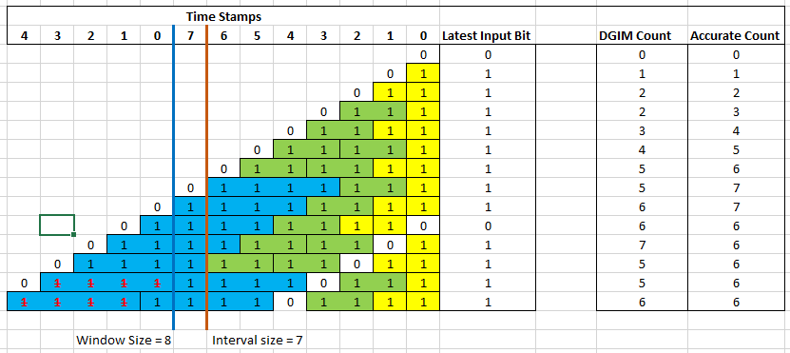
DGIM Algorithm – Example Run

Slide 43
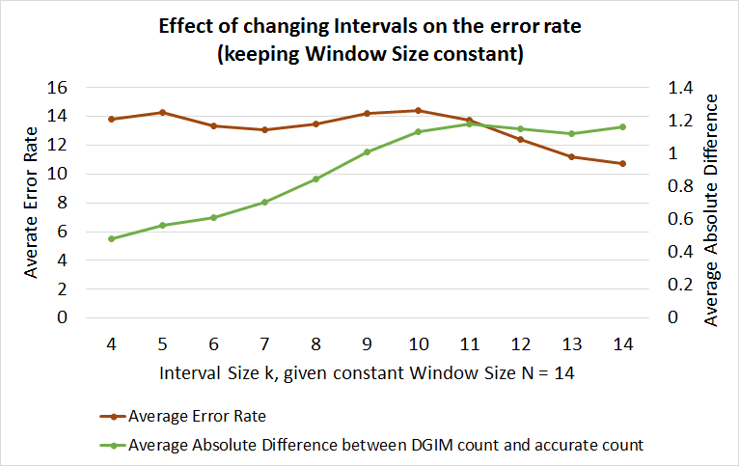
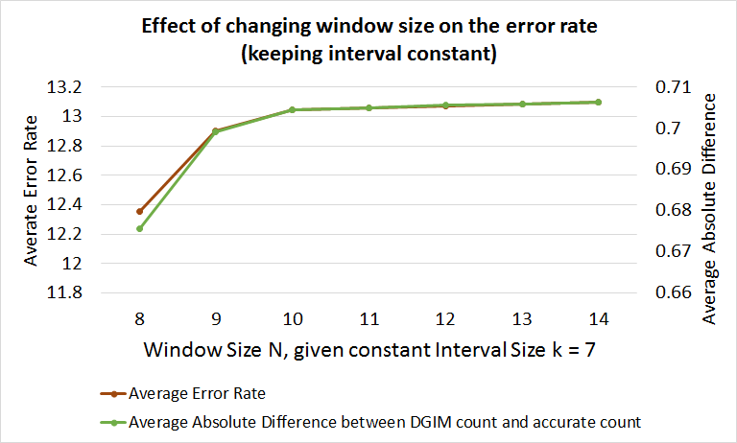
DGIM Algorithm – Error Rate Behavior

Slide 44
Domain Analytics
Dive into Meetup Streams

Slide 45
City level Interest Groups based on events created
In this topology, we have attempted to find the inclination of each city for different categories of events, based on the number of events getting created in each city under each category.
This data can be useful in identifying not just the interest areas of a particular city, but even deriving what diverse a category of events happen in that city.
For this, we have used open_events stream to get number of events happening, on per city and per category basis. The topology gives data patterns for each city appearing in the open_events stream

Slide 46
City Interest Group Based on RSVPs
Commenting on a city's interest area on the basis of events getting created, may not be sufficient
For this, one approach could be to count the number of RSVPs for each event and map this numbers to the corresponding categories of the events
This could give a better picture of interest of people in each city
IT is not just about the events getting generated, it is about those events getting RSVP responses
For this, we have used the RSVPs stream to get the number of 'Yes' RSVPs on events and then aggregating counts of 'Yes' RSVPs across each category of events.

Slide 47
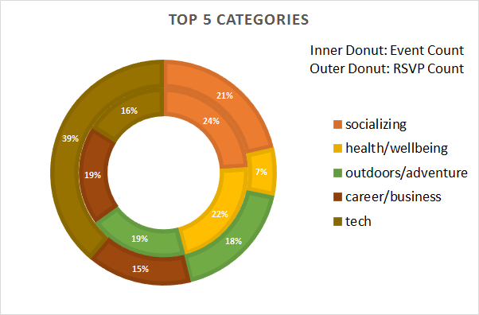
Data Observations
Results showing interest groups based on events counts and rsvps received .

Slide 48
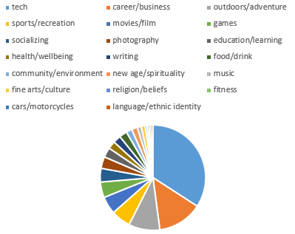
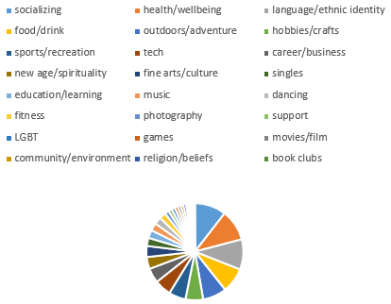
Bangalore London

Slide 49
Project Conclusions

Slide 50
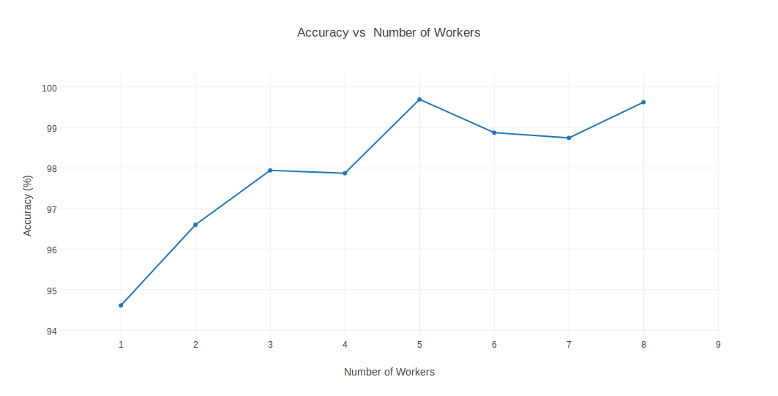
Accuracy of Durand Flajolet Approximation for unique Count
Accuracy of Durand Flajolet Approximation against Exact Count – with increase of streaming data, data rate and number of workers.

Slide 51
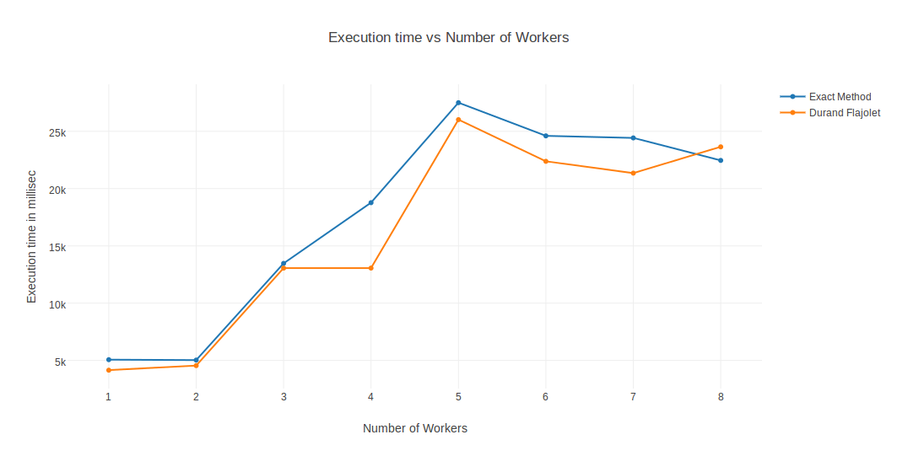
Total processing duration per tuple – Distinct Count Problem
Total processing time per tuple is plotted against the number of workers (i.e. Spouts and Bolts). It was observed that the execution time first increased up to the number of workers being 5, thereafter, it is staying to about 20-25 sec.

Slide 52
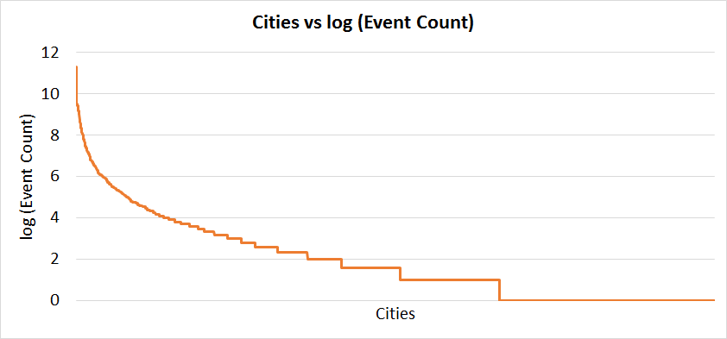
Power Law distribution for event count against cities
Cities follow a power law distribution in terms of numbers of events getting created. Few Cities contribute to major number of events. The result is similar in case of RSVPs too.

Slide 53
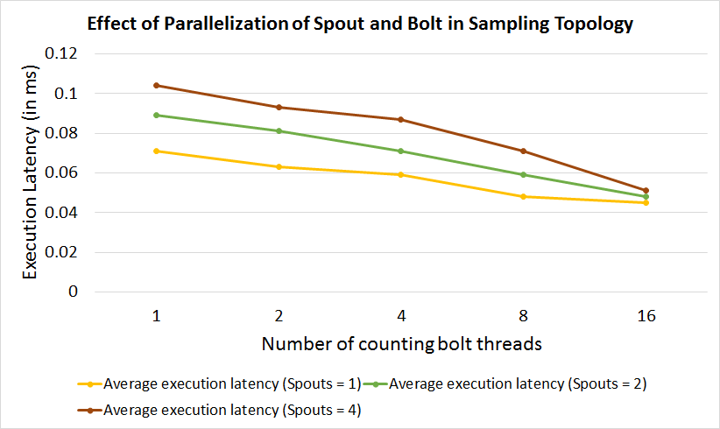
Thread level parallelism for Sampling topology
Effect of thread level parallelism in Apache Storm, as observed on the Sampling topology

Slide 54
Thank You

